Slide 1
Social Network Data Analysis
Member : 彭顯詠 黃柏鈞 蔡霈炫 郭士煒

Slide 2
Dataset roadNet-PA
Nodes : 1088092
Edges : 3083796

Slide 3
Average Degree
3083796(edges) / 1088092(nodes) = 2.83413167269

Slide 4
Average clustering coefficient
0.0465
Notes:
透過Average clustering coefficient觀察Pennsylvania道路
路口連接出去的各個路口互相連通機率平均為 4.65%
Transitivity偏低
路口最多可連接數不高
因為道路限制(if 圓環設計 transitivity會較高)

Slide 5
Diameter
768
https://gist.github.com/p208p2002/2d16046d0a067628d9f8916ff443ba62
Notes:
從Pennsylvania任意一處最多只需經過768即可到Pennsylvania的任一路口

Slide 6
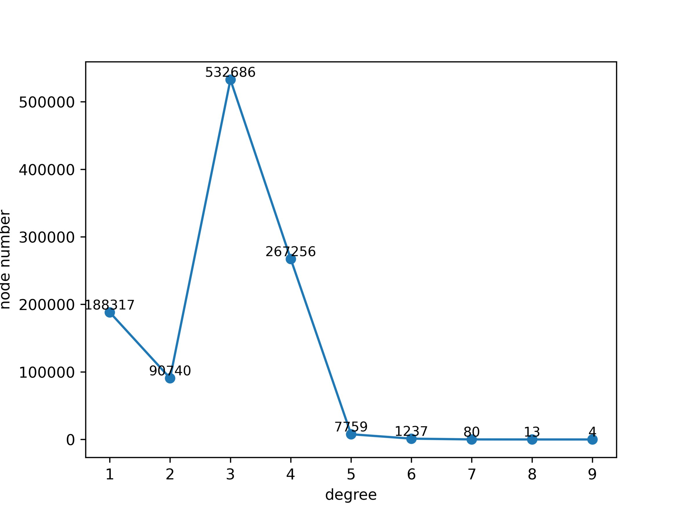
Degree Distribution

Slide 7
Reference:
https://snap.stanford.edu/data/roadNet-PA.html

